Slide 1
The effectiveness of a nurse-delivered breast health promotion program on breast cancer screening behaviours in non-adherent Turkish women: A randomized controlled trial
Selda Secginli *, Nursen O. Nahcivan
Istanbul University, Florence Nightingale School of Nursing, Public Health Nursing Department, 34381 Sisli-Istanbul, Turkey

Slide 2
Introduction
Mammography, clinical breast examination (CBE), and breast self-examination (BSE) are recommended methods to detect early breast cancer in women.
The effectiveness of mammography is well established and considered to be the most important and specific method of detecting breast cancer early.
The BSE and CBE remain additional methods to detect breast cancer and represent noninvasive options.

Slide 3
Factors have been linked with BSE and mammography use.
health beliefs
attitudes to breast cancer
breast cancer knowledge
access to a usual source of care
socio-economic status
level of education
health insurance coverage
family history of breast cancer
having a regular physician
lack of physician recommendation

Slide 4
cultural factors have also been linked with mammography
a fatalistic view toward cancer
perception of screening as unnecessary in the
absence of symptoms
strong sense of modesty
placing a priority on the needs of their children
the prohibiting islamic rule of self-exposure in front of any man other than one’s husband

Slide 5
In many studies aiming to promote breast health,
BSE frequency has been the outcome used to measure increases in BSE practice and less attention has been given to BSE proficiency.
Both frequency and proficiency are important
aspects of BSE and measuring frequency of BSE without considering proficiency of skills used in the exam is less value laden.

Slide 6
purpose
to determine the effects of a breast health promotion (BHP) program on BSE frequency and proficiency (BSE skills and lump detection), and mammography and CBE use in a sample of Turkish women.
The effects of the BHP program on breast health knowledge and health beliefs about breast cancer screening were also evaluated.

Slide 7
Methods
An experimental pretest–posttest control group design was used.
Participants were randomly assigned to an intervention group or control group.
Participants in the intervention group received a breast health promotion (BHP) program.
Control group participants received usual care from the health center.
In the study, after the data collection ended at 6 months, the BHP program is implemented to women in the control group.

Slide 8
Outcome measures
changes in
the frequency of BSE
proficiency of BSE
frequency of mammography
frequency of CBE
changes in
breast health knowledge
in health beliefs.

Slide 9
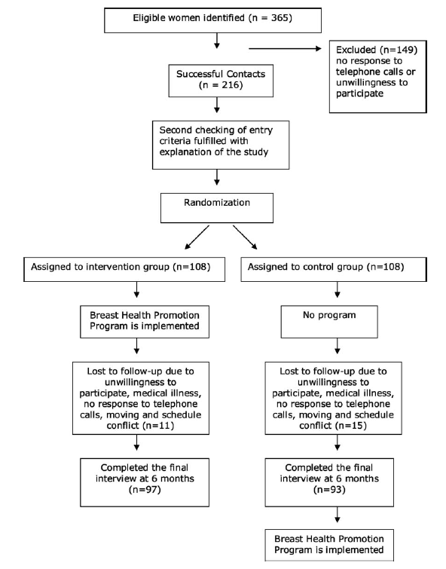
Fig. 1. Flow diagram of study participants.

Slide 10
Procedures
All study activities were approved by the University Health Institutional Review Board.
Ethical approval was received from the city provincial health director, the director of health center and the primary school from where the participants were recruited.
Informed consent was obtained in a face-to-face interview from all participants before initiation of the study.

Slide 11
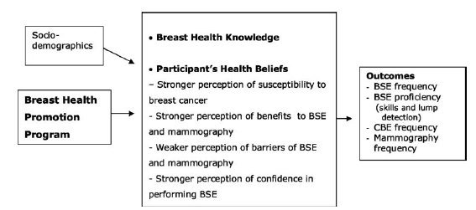
Fig. 2. Conceptual framework of the constructs of the health belief model: perceptions of susceptibility, benefits, barriers, and confidence.

Slide 12
the BHP program was given to women in the intervention group after the pretest questionnaires were administered.
At the conclusion of the BHP program, the women were administered the posttest questionnaires.
Approximately 3 and 6 months after the BHP program, each participant was called and set up a time to meet in the health center, to complete the follow-up surveys.

Slide 13
breast health promotion (BHP)program
The BHP program aims to promote breast health knowledge and beliefs conducive to improve BSE, CBE, and mammography behaviours.
Health education
A 35-min teaching session
information on breast anatomy, incidence, mortality, risk factors for breast cancer development, breast changes, BSE, CBE, and mammography, the importance of early detection of breast cancer and treatment options of breast cancer, and messages related to susceptibility to breast cancer, confidence for BSE, the perceived benefits and barriers to BSE, and the perceived benefits and barriers to mammography, and access to screening services
In a 15-min film
The English version of MammaCare Corporation BSE film titled, ‘‘Instructions for Breast Self-Examination’’
BSE instruction
The individual BSE instruction (15 min) used is a standard size five lumps version available from Health Edco, WRS Groups Ltd., Waco, TX, US
Booklet
27-page booklet entitled ‘‘Breast Cancer: Being Healthy is in Your Hands’’
Calendar
entitled ‘‘Three Steps for Breast Health’’
Card
‘‘Steps to Breast Self-Examination’’

Slide 14
Instruments
The demographic data questionnaire
age, current marital status, years of education, employment status, income level, having children, length of residence in Istanbul, and health insurance coverage, having knowledge of breast cancer, BSE, and mammography, having a family history of breast cancer, gynaecologist as a regular physician.
The follow-up questionnaire
‘‘regular BSE” or ‘‘irregular BSE’’.
Breast Self-Examination Proficiency Rating Instrument (BSEPRI)
checklist with ten items measuring BSE inspection and palpation skills (score to 100)
The lump detection skill
Champion’s Health Belief Model Scale (CHBMS) of breast cancer screening
health beliefs of susceptibility (5 items), benefits of BSE (6 items), benefits of mammography (6 items), barriers to BSE (6 items), barriers to mammography (5 items), and confidence (11 items)
The breast health knowledge (BHK) form
knowledge about breast cancer. The 22-item form

Slide 15
Statistical analysis
The data were analyzed by using SPSS, version 11.
Chi-square tests for categorical data and independent t-tests for continuous data were used.
And chi-square test, t-test, and Mann–Whitney U-test were used to assess changes in mammography, CBE, and BSE rates.
The t-tests were used to assess changes in health beliefs from pre- to post-intervention.
Repeated measures analysis of variance (ANOVA) was used to evaluate the changes in knowledge of breast health over time within the intervention and control groups.
Adjusted odds ratios and 95% confidence intervals (CI) are reported for practicing BSE at the 3- and 6-month follow-ups.
All tests of significance are evaluated at the p < 0.05 level.

Slide 16
Results
97 in the intervention group, 93 in the control group.
The mean age of the sample was 46.59 years (range = 41–59; SD = 4.23).
The majority were married (92%) and not working (73%).
Fifty-four percent of the sample had attended school for 1–8 years, and 46% had attended school for more than 9 years.
Most participants perceived income level middle (75.8%), bad/very bad (8.4%) and good/very good (15.8%).
With regard to health status perception, 44% reported being in good to excellent health, and 56% reported fair health.
Ninety-two percent of women had health insurance,
all the participants were residing in Istanbul at least 5 years.
There were no significant differences between participants’ characteristics at baseline among the two groups (age, marital status, years of education, employment status, income level, having children, length of residence in Istanbul, and health insurance coverage).

Slide 17
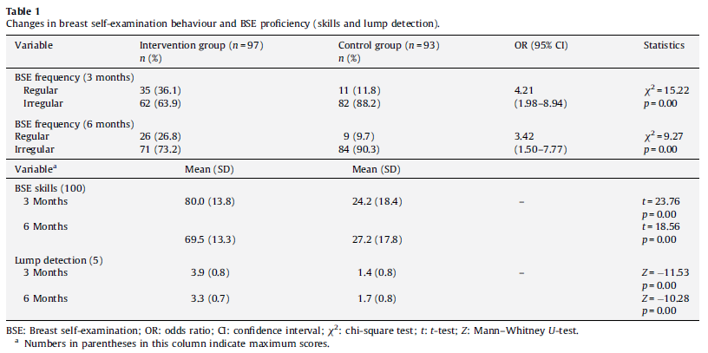
Change in BSE frequency and BSE proficiency

Slide 18
Among those who never performed BSE before the BHP program, 36.1% (n = 35) of the intervention group and 11.8% (n = 11) of the controls initiated to perform BSE in the 3 months. Likewise,26.8% (n = 26) of the intervention group, and 9.7% (n = 9) of the control group performed regular BSE at the 6 months after the BHP program.
At 3-month followup, BSE skills mean scores were significantly higher for the intervention group (x = 80 out of 100, SD = 13.8) compared with control group (x = 24.2 out of 100, SD = 18.4) (p < 0.001). At 6-month follow-up, BSE skills mean scores were 69.5 (SD = 13.3) for the intervention group, and 27.2 (SD = 17.8) for the control group (p < 0.001).
At 3-month follow-up, mean lump detection scores were higher for the intervention group (3.9 out of 5, SD = 0.8) than for the control group (1.3 out of 5, SD = 0.7). It was 3.3 (SD = 0.7) for the intervention group and 1.6 (SD = 0.8) for the control group at 6-month follow-up (p < 0.001).

Slide 19
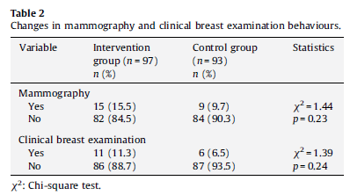
Change in mammography frequency and clinical breast examination frequency

Slide 20
At baseline, women were non-adherent with respect to mammography and CBE guidelines.
Rates of mammography use in the intervention versus control group were 15.5% versus 9.7%,
and rates of CBE use in the intervention versus control group were 11.3% versus 6.5%.

Slide 21
Change in breast health knowledge
Before the BHP program, the intervention group’s mean level of knowledge (8.85±2.40) was essentially the same as the control group (8.98±2.45) and there was not a statistically significant difference between the two groups in the mean breast health knowledge scores (p = 0.73).
At the 3-month data collection, the mean knowledge score of 18.16± 1.47 for the intervention group was significantly higher than the mean score of 9.96±2.69 for the control group (p < 0.001).
At the 6-month data collection, the intervention group’s knowledge scores (x = 16.46) had decreased, while the control group’s knowledge scores (x = 10.13) had increased from the 3-month measurement and the mean knowledge score of the intervention group was significantly higher than the mean score of control group (p < 0.001).

Slide 22
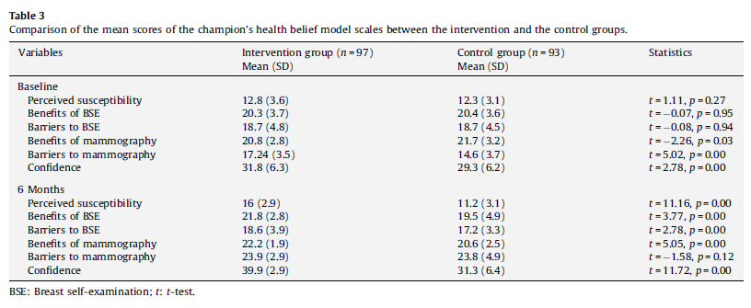
Changes in health beliefs

Slide 23
For the intervention group,
Increase
perceived susceptibility,
perceived benefits of BSE and mammography, and
confidence
Decrease
perceived barriers to mammography
No changes were
perceived barriers to BSE.
For the control group,
Increase
confidence,
perceived barriers to mammography
Decrease
perceived susceptibility,
perceived barriers to BSE,
perceived benefits of mammography

Slide 24
Discussion
In this study, the BHP program significantly improved BSE rates among women.
However, it did not have the anticipated effect on CBE and mammography rates.

Slide 25
1. In the current study, BSE performance was evaluated with both BSE frequency and BSE proficiency (skills and lump detection).
Teaching BSE significantly improves the BSE performance.
The results are in line with those of several earlier studies reporting that BSE training increases the frequency of BSE and increases women’s understanding of the technique (Avci and Gozum, 2009; Budakoglu et al., 2007; Coleman et al., 2003; Funke et al., 2008; Hacihasanoglu and Gozum, 2008; Lee et al., 2003; Lu, 2001; Luszczynska, 2004; Sorensen et al., 2005; Taylor, 2002; Wood and Duffy, 2004; Wood et al., 2002).
women in Taylor’s study (2002) did not improve their BSE technique after participation in a 2-h BSE education program.

Slide 26
In addition to BSE frequency, the woman’s ability to perform BSE correctly is at least equally important.
In the current study, women who had participated in the BHP program were more likely to perform BSE proficiently at 3 and 6 months after the program.
Using a breast model may be an effective way to teach BSE.
The findings of the current study are congruent with several researchers (Funke et al., 2008; Hall et al., 2007; Pinto and Fuqua, 1991; Sorensen et al., 2005; Taylor, 2002; Wood and Duffy, 2004)
Other studies have demonstrated the favorable impact of video instruction and return demonstration on enhancing a woman’s confidence in performing BSE, thus increasing both frequency and proficiency (Champion, 1995; Hall et al., 2007; Janda et al., 2002; Wood, 1996; Wood and Duffy, 2004; Wood et al., 2002).
Therefore, the BHP program may be appropriate to increase both BSE frequency and proficiency for future samples with similar demographic characteristics.

Slide 27
Five lumps were embedded in the breast model, but mean number of lumps found by the intervention group at first posttest was 3.88, and 3.31 at the second posttest.
Therefore, further studies linking BSE skill deficits to lumps not found is needed to clarify present findings.
Future studies may require BSE training sessions with a focus on the most essential components to achieve criterion levels of BSE skill competency.
Wood et al. (2002) stated that missing key BSE skills, such as pressing lighter to deeper breast tissue or failing to cover all areas of the breast, would result in finding fewer lumps when they are present.

Slide 28
2. One of the study hypotheses was that there will be a significant difference in mammography and CBE adherence rates between women in intervention and control groups at 6-month post-intervention.
However, there was no evidence to support this hypothesis.
This result was achieved in a shortened follow-up period of only 6 months in this study.
→A longer follow-up period of 1 or 2 years, which would have been consistent with current screening mammography recommendations, would have been ideal.

Slide 29
Another reason for the insignificant difference in mammography and CBE adherence rates in this nurse-led study may be the absence of an opportunity to schedule a mammogram and physician recommendation.
Physician recommendation to obtain mammography has been found to be associated with women’s use of mammography (Champion et al., 2003; Michielutte et al., 2005; Sohl and Moyer, 2007; Soskolne et al., 2007).
the barriers such as access, availability, and affordability of services may have affected the CBE and mammography behaviours.
Tejeda et al. (2009) reported that a combination of access enhancing strategies such as reduced cost mammograms, facilitated scheduling, mobile clinics, vouchers, and transportation to appointments were effective in increasing rates of mammography use.
non-adherent women are less responsive to interventions to increase screening than are women who have had prior mammograms (Champion et al., 2003)
In the current study, women were non-adherent upon entry and access-enhancing strategies were not used.
Thus, coordination and assistance with services to facilitate CBE and mammography screening may be preferable strategies for future interventions.

Slide 30
A possible explanation of the women’s decision about mammography and CBE might be influenced by cultural factors. women are
Reluctant to be examined by the male health care personal.
Male heads of households have a significant influence over Turkish women’s health care decisions, Turkish women did not give their attention to the symptoms they were experiencing and they placed a priority on the needs of other family members, especially their children.
This may be also interpreted as an educational intervention that considers cultural barriers to screening in addition to the health beliefs may be needed in this population.

Slide 31
3-a. In the literature, health beliefs and the breast health knowledge have been shown to correlate significantly with having a mammography, CBE, and practicing BSE.
The increases in perceived susceptibility,benefits of BSE and mammography, and confidence in this study is consistent with past literature demonstrating that breast cancer education programs influence women’s health beliefs (Avci and Gozum, 2009; Garza et al., 2005; Gursoy et al., 2009; Hacihasanoglu and Gozum, 2008; Hall et al., 2007; Han et al., 2009; Lu, 2001).

Slide 32
4. We have little explanations as to why the levels of perceived barriers to BSE of the intervention group were increased at posttest and no significant difference was found in the levels of perceived barriers to mammography between the two groups.
the BHP program failed to produce an overall effect on perceived barriers.
→Negative side effects of the BHP program such as increased risk perception, provoked anxiety about what they are feeling is normal breast tissue or is indeed a mass that needs further investigation.
It may also likely that after the intervention, the participants became more aware that BSE is difficult to do correctly, it is time consuming, the procedure is unpleasant and embarrassing.
The cultural variables may be an important component of Turkish women’s decision about breast screening and should be confirmed in future research.

Slide 33
3-b. In the current study, the intervention was successful and appears to be associated with producing significant increases in breast health knowledge as well. Also knowledge is an important element in the HBM.
Although mean pretest scores for breast health knowledge of two groups were similar, the intervention group significantly differed from the control group at all posttests.
This finding is consistent with previous studies that breast health interventions significantly improve the breast health knowledge (Garza et al., 2005; Lee et al., 2003; Rao et al., 2005; Wood et al., 2002).

Slide 34
3-cWomen’s confidence level increased over time in the study.
BSE confidence positively correlates with the frequency of carrying out BSE (Fry and Prentice-Dunn, 2006; Janda et al., 2002; Luszczynska, 2004; Park et al.,2009).
Park et al. (2009) reported that women’s confidence in performing proper BSE was improved by teaching breast awareness and BSE.
Findings in the current study support the premise that a targeted intervention that correlates with women’s health beliefs can help women carrying out monthly BSE.

Slide 35
Limitations
The study relied on a small sample of women in one region, and thus it has limited generalizability. The study should be replicated with a larger and more diverse sample.
The one-off brief nature of the intervention and the short-term follow-up period (only 6 months after the intervention) are also substantial limitations.
Although, in the study, the reliance on self-reports of mammography and CBE behaviours is a limitation, self-report of mammography use has been validated previously and appears relatively accurate.
HBM does not consider the role of culture on health behaviours, and therefore, was not assessed in this study.

